Slide 1


Bangalore India Open Lightpath Exchange Facility for Global Scientific Cooperation
BIxLight
Leena Chandran-Wadia
Observer Research Foundation Mumbai
Amit Apte
TIFR Centre for Applicable Mathematics and ICTS-TIFR
GLORIAD Workshop on Advanced International Network Exchanges
Hong Kong University, 20 January 2012

Slide 2
Outline
  Communities and Applications through
    ICTS Meeting of February 2011 on "Scientific Discovery through intensive exploration of data“
    US-India Network Enabled Research Collaboration
    US-India Workshop on Virtual Institutes for Computing and Data Enabled Science & Engineering (CDS&E)
    Interaction with Council for Scientific and Industrial Research (CSIR) - Open Source Drug Discovery (OSDD) team
  Facilities
  Activities
  Challenges
  Future Plans

Slide 3
Scientific discovery through intensive exploration of data (SDIDE)
  An 11-day long ICTS program, February 2011,Bangalore (Convenors: Amit Apte and Ravi Nanjudiah)
  Main themes:
    use of vast amounts of observational, experimental, and numerical data and computations for scientific explorations
    mathematical and computer science aspects of storing, accessing, visualizing, and analyzing large data
    Panel discussion on Genomics
    Panel discussion on IT infra-structure in India - Many scientists expressed their frustration over the lack of technology support for their research

Slide 4
Areas of Interest - SDIDE
    Earth Sciences
      IISc Bangalore, TIFR-CAM
    Life Sciences and Health
      NCBS, IISc Bangalore, CSIR, IBAB, Strand Life Sciences, IIT Bombay
    High Energy Physics & Astronomy
      TIFR, TIFR-NCRA
    Materials Science and Chemistry
      JNCASR, IISc Bangalore, Univ. of Hyderabad
    Computer Science, Technology and Statistical Methods
      Microsoft, TCRL, Intel, IBM, IISc Bangalore, IIT Bombay
  Report: http://www.icts.res.in/program/Datasci2011

Slide 5
US-India Network Enabled Collaboration
http://internationalnetworking.iu.edu/us-india-workshop
Indian partners: ERNET, CDAC and NKN (Ministry of Information Technology)
Additional areas of interest: Medical research, particularly Cancer research
Research Institutions:
  IUCAA,
  NRSA,
  NARI, TMH, AIIMS,
International: Indiana University, Pacific Rim Access and Grid Middleware Assembly

Slide 6
    US-India Workshop on Virtual Institutes for CDS&E
http://nsfcac.rutgers.edu/cdse/us-india-workshop/
Theme: CDS&E under the umbrella SAVI (Science Across Virtual Institutes)
New Areas of Interest: Mathematics and LIGO (Laser Interferometer Gravitational Observatory)
Indian Partners: IISc Bangalore, RRI, IUCAA, ISI, CMI, TIFR-ICTS
International partners: ICERM (Brown), SAMSI
  Stuart Anderson, Caltech
  Peter Arzberger UCSD
  John Towns, NCSA,
  Manish Parashar, Rutgers University,
  Sastry Pantula, Ed Seidel, Gabrielle Allen, NSF/DMS&OCI

Slide 7
Council for Scientific and Industrial Research
Large spread of institutions all across India – high speed networks critical
Open Source Drug Discovery team – Young, Dynamic, backed by strong Director General
CSIR is also setting up a new institute for the Data Intensive Sciences in Bangalore
Solutions for Affordable Healthcare and Sustainable Development are some critical areas of research
Prime Minister is the President of CSIR
CMMACS is also a partner in BIxLight

Slide 8
Administration and Funding of S&T
Prime Ministers’ Office
  Department of Atomic Energy
  Department of Space
Ministry of Science and Technology – DST, CSIR
Ministry of Earth Sciences
Ministry of Communication and Information Technology – ERNET, CDAC, NKN (partly)
Ministry of Human Resource Development
No NSF like institution yet. SERB (Science and Engineering Research Board) to start soon

Slide 9
BIxLight Project
(Facilities and Activities)

Slide 10
A pilot project
  Outcome of the Panel Discussion at SDIDE, February 2011
  Spurred by the free1Gbps international link to GLORIAD on offer from Tata Communications (work order released)
  11 ‘Scientific User’ groups signed up – more interested
  Partner (national and international) institutions identified for assistance with technologies
  Funding options for shared infrastructure:
    Pilot phase: Indo-US endowment (failed!). In discussions with Infosys and with government
    Local 1Gbps links to participating labs (Karnataka government)
    Cloud support for computing etc. (collaboration with Industry)

Slide 11
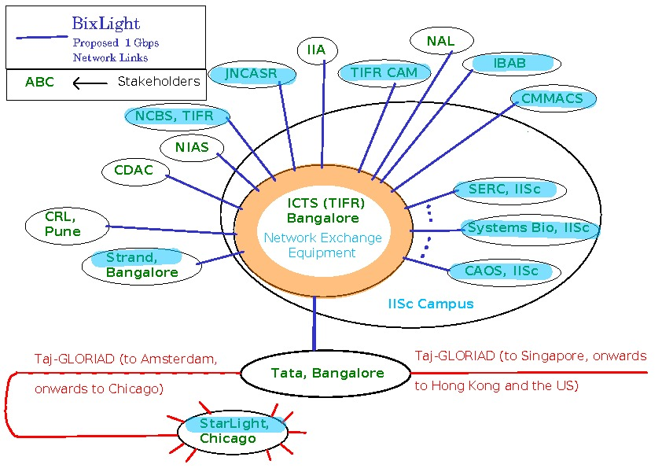
BIxLight - A local and global network

Slide 12
Phased rollout of shared Infrastructure
  Mirrors of internationally available science research datasets and storage for locally generated data - Pilot
  High-performance network connectivity from individual institutions to the location of data - Pilot+
  Computing resources at the location of the data – Pilot+
  Helpdesk and Services along with a huge capacity building effort – Second phase
  Peering with NKN, ERNET – Second phase
  Location of facility:
    Preferably ICTS office at the IISc Bangalore
    Else Tata Communications in the Co-Location model

Slide 13
What will the project achieve?
Create India’s first community-owned and operated “open exchange” for advanced research and education communications services.
Establish the JISC type institution for envisioning technology use in research and education.
Provide opportunity for capacity building and collaboration within and among research institutions.
Help identify new and innovative ways in which industry and academia can work together on such high value projects
Create a successful model for the deployment of shared technology infrastructure in other areas of education and research

Slide 14
Challenges
  Lack of sufficient opportunity for Scientists, Engineers and Technologists to work together at our research institutions
  Paucity of skilled technology professionals at research institutions.
    Only a few institutions have adequate support facilities for CDS&E
    IISc Bangalore – Supercomputer Education and Research Center
    TIFR and IITs
  Some solutions could be
    work with industry to compensate (short term). Need to evolve appropriate business models.
    undertake large capacity building efforts (long term)
  Lack of clarity regarding the separate role of the NKN vis-a-vis BIxLight

Slide 15
Other Challenges
No equivalent of the dark Fibre law in the US – most of the fibre is in private hands (Telecom companies). Most routes we choose will require fibre to be laid.
Fibre cuts – at least 50 times more frequent in India!
Appropriate business models (non-profit?) for scientists to work with Industry Partners – given salary differentials and paucity of talent on campuses
  Infosys Innovation labs, Tata Companies
  Multinational companies – Intel, IBM, Cisco

Slide 16
Strengths
User Community!
  Impatient to go and have leverage to push for this
  Prospect of new projects such as LIGO and CSIR
Supportive State Government
  Could consider funding local links. Talks in progress.
High level of Interest among Industry players
  Tata, Infosys and Intel already involved

Slide 17
Future Plans
Find some funding and GO!
    Karnataka government, DST
    Foundations – Infosys, Reliance
    SERB/DST
Phased rollout of infrastructure
  Mirrors of Databases
  High-speed connectivity to partner institutions

Slide 18
Takeaways from Workshop
Technology! Catch up on
  Technology aspects of Lightpath exchanges
  Databases
Capacity building efforts – School in India?
Business models (best practices)
  Creation of a new institution?
Opportunities for collaboration and new friends ☺

