Slide 1
An Overview of
HARNET
Hong Kong Academic & Research Network
David Choi
NTF - JUCC
Notes:
1
1

Slide 2
HARNET
Established in 1985; connect to Internet in 1991
The wide area network which links up the campus networks of the 8 tertiary institutions in Hong Kong.
HARNET also provides network connectivity to its affiliate members and network members
Gateway for connecting to overseas Academic and Research networks
Funded, Planed, Managed and Operated by Joint Universities Computer Centre (JUCC)

Slide 3
JUCC
A consortium of Computing and IT Services Centers of all the Government-Funded Universities in Hong Kong
Founded in 1970, initially for
  Operating the scarce and shared computer resources
  Supporting the member institutions on computation needs
Has established to be an IT lead organization
  Fostering deep collaborations among higher education institutions in Hong Kong
  Providing up-to-date IT facilities and support services for academic and research excellence
Notes:
3
3

Slide 4








JUCC Members
8 full members, funded by University Grants Committee (UGC)
  The University of Hong Kong (www.hku.hk)
  The Chinese University of Hong Kong (www.cuhk.edu.hk )
  The Hong Kong Polytechnic University (www.polyu.edu.hk)
  City University of Hong Kong (www.cityu.edu.hk )
  Hong Kong Baptist University (www.hkbu.edu.hk)
  The Hong Kong University of Science and Technology (www.ust.hk)
  Lingnan University (www.ln.edu.hk )
  The Hong Kong Institute of Education (www.ied.edu.hk)
Notes:
4
4

Slide 5





JUCC Members
3 affiliate members
  The Open University of Hong Kong (www.ouhk.edu.hk)
  Vocational Training Council (www.vtc.edu.hk)
  University of Macau (www.umac.mo)
2 network members
  Hong Kong Examinations and Assessment Authority (www.hkeaa.edu.hk)
  Hong Kong Science & Technology Parks (www.hkstp.org)
Notes:
5
5

Slide 6
Working Groups
Task Forces
  Network Task Force
  Information Security Task Force
  Ad-hoc groups on special projects (e.g. Wi-Fi Technical Group, Anti-virus Software Evaluation Group)
Special Interest Groups
  SIG on User Services

Slide 7
Additional Information
Current JUCC Officers:
Board Chairman: Being nominated
Director of JUCC: Mr Gerrit Bahlman, Director of IT, PolyU
& Chairman of (Since Jul 2010, for a term of 2 years)
Steering Committee
NTF Chairman: Mr David Choi, Senior Computer Officer, CUHK
ISTF Chairman: Mr Gerrit Bahlman, Director of IT, PolyU

Slide 8
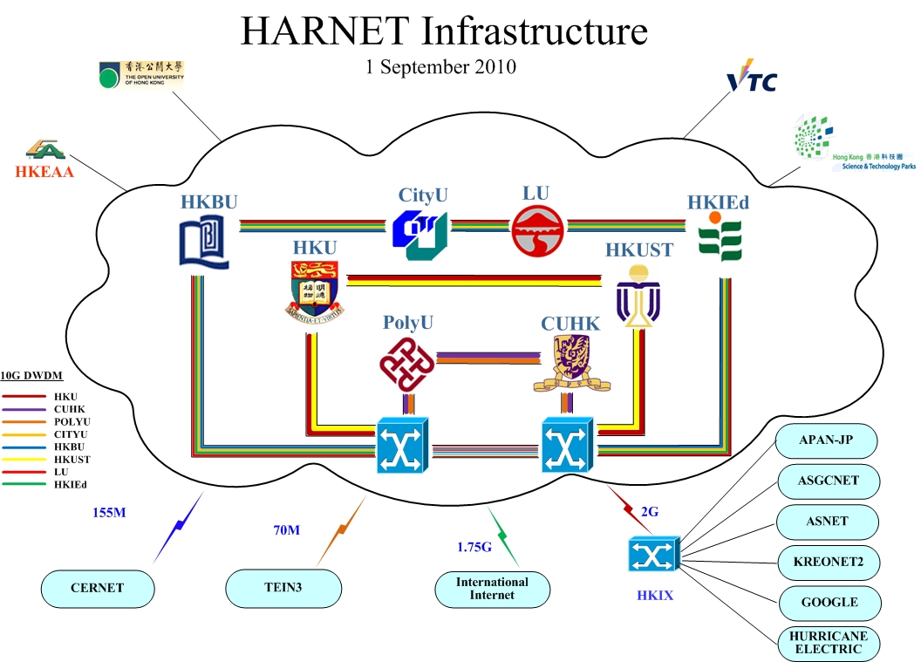

Slide 9
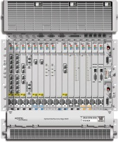
HKIEd
Cisco7603
CUHK
Cisco7603
HKUST
Cisco7603
HKBU
Cisco7603
OME6500
GE
17km
OME6500
GE
15.7km
OME6500
GE
13.8km
OME6500
GE
2 GE
2 G FC
2 GE
2 GE
2 G FC
26.3km
2 G FC
2 G FC
3 GE
Media Converter Shelf
GE
10Gbps MSSPRing
32.68km
17.78km
19.48km
17.5km
LU
Cisco7603
PolyU
Cisco7603
HKU
Cisco7603
CityU
Cisco7603
GE
GE
GE
OME6500
OME6500
9.66km
OME6500
OME6500
2 GE
32.3km
2 GE
15.6km
12.7km
2 GE
2 G FC
2 G FC
2 G FC
Internet2 GE
2 G FC
3 GE
Media Converter Shelf
One GE each for CUHK, HKIEd, LU and PolyU
OMEA
International
connections
ONE GE each for HKUST, HKBU, CityU and HKU
The 1st Optical HARNET
Media Converter Shelf
Notes:
MSSP – Multi-services Platform

Slide 10
The 1st Optical HARNET
The 1st Optical HARNET started in 2006
Consists of 2x10G Rings
Based on Nortel OME 6500
CUHK, HKU, PolyU & HKUST connected with 2 rings
Aimed at
  Enhancing HARNET Resilience
  Connecting to CNGI and CERNET2
  Connection to HKLight/GLORIAD
  Connection TEIN2
It still exist but without Maint. & Support

Slide 11
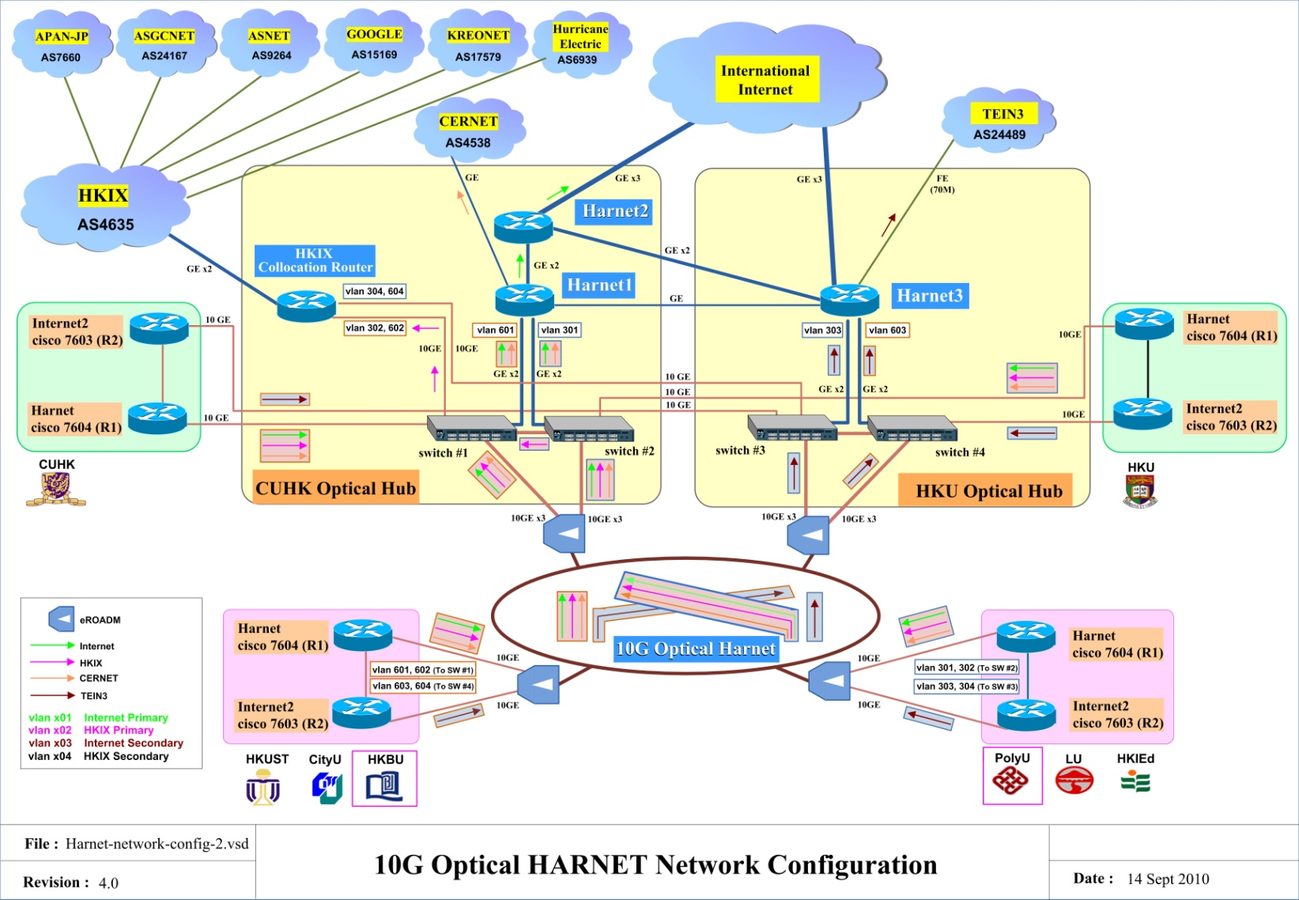
The Current HARNET

Slide 12
The Current Optical HARNET
A DWDM backbone with 40 Lambdas connecting 8 member institutions
HKU and CUHK serve as Hub Data Centers
Each institution with 2x10G connecting to layer-2 10GE switches at the 2 Hub Sites
5x10G & 3xGE between the 2 Hub Sites

Slide 13
The Current Optical HARNET
Based on ADVA multi-degree ROADM optical technology, up to 40 Lambdas (only used 17)
Multi-ring topology to allow high fault tolerance and high flexibility for connecting new nodes and incremental upgrades
With Multi-degree ROADM Point to Point 10G any-to-any is possible
Unfortunately it is a managed (not owned) DWDM services
3-year managed wavelength service contract

Slide 14
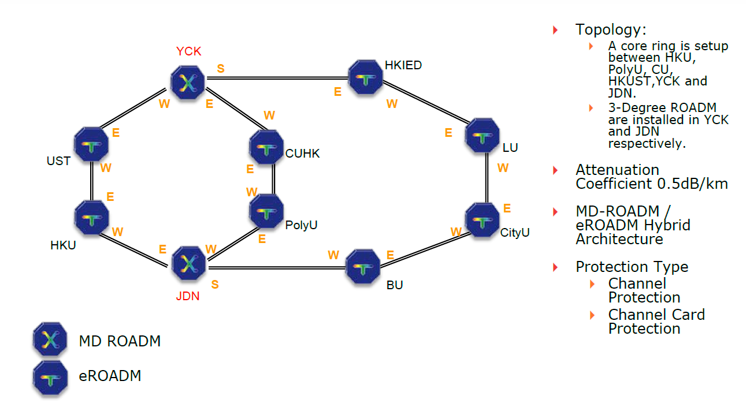
The Current Optical HARNET

Slide 15
The Current Optical HARNET Targets
A high-speed multi-gigabit optical network infrastructure for the Next Generation HARNET
Provides on-demand lambda bandwidth between institutions for research applications
Connecting advanced International R&E Optical networks

Slide 16
Optical HARNET prospective applications
High Performance and GRID computing applications
Multi-party high-quality high-definition videoconferencing
VOIP (Voice Over IP) deployment
Off-site disaster recovery data centers
Remote SAN through fibre-channel connections
Tele-medicine, digital libraries, virtual classrooms, etc.

Slide 17
HARNET/Internet Connections
  3 x Gbps links to an ISP for International/Commodity Internet;
    Bandwidth subscription - Currently at 2Gbps; will upgrade to 4Gbps
    Will upgrade to dual-stack during March 2012
    QoS – 95%
2 Gbps links to HKIX for Local Internet
Collocation connections to NRENs:
  155 Mbps link to CERNET
  90 Mbps link to TEIN3
Private Peering via HKIX
  Hurricane Electric, APAN-JP, ASGCNet, KREONET
  ASNET, TANET, Google

Slide 18
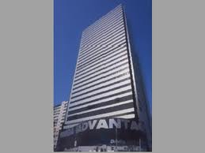
Mega-I Advantage
Located in Chai Wan in Eastern part of HK Island
Important Carrier Hotel in HK
Essentially all submarine / terrestrial cable operators have presence there
Good for physical interconnections
But colo space is running out
  Colo and Cross Connect charges increasing
CUHK/HKIX has a small POP there to serve R&E networks only
  One 10GE link back to HKIX should serve multiple interconnection requirements

Slide 19
R&E Networks in Mega-i
ASCC/ASNET: 5/F
ASGC: 12/F inside PACNET
CERNET/CERNET2/CNGI-6IX: 8/F
CSTNET/GLORIAD: 32/F Meet-Me Room
CUHK/HKIX: 32/F Open Farm
KISTI/KREONET2: 12/F inside PACNET
NICT: 10/F
TEIN3: 8/F

Slide 20
Fiber Cross Connect Inside Mega-i
Same charge for MMF & SMF
Ordering may be complicated if more than one party is involved
iAdvantage now have monthly charge even for Fiber Cross Connect within the same floor
If not a lot of traffic, HKIX switch at Mega-i can be used for interconnections among R&E networks to avoid managing and paying multiple fiber cross connect cables

Slide 21
Wharf T&T
AS9381
NTT
AS2914
ASCC
AS9264
CERNET
AS4538
…..
CERNET2
AS23910
Other
Universities
in HK
CNGI-6IX
AS23911
HARNET
AS3662
HKIX Layer 2
(MLPA:AS4635)
at CUHK
at HKU
at CUHK
at Mega-i
NUS
AS7610
CUHK
AS3661
APAN-JP
AS7660
TEIN3
AS24489
KREONET2
AS17579
ASGC
AS24167
CSTNET
AS7497

Slide 22
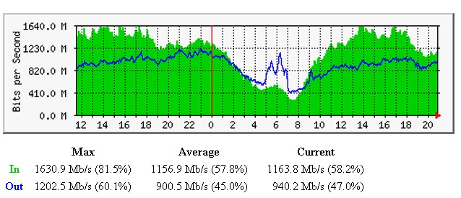
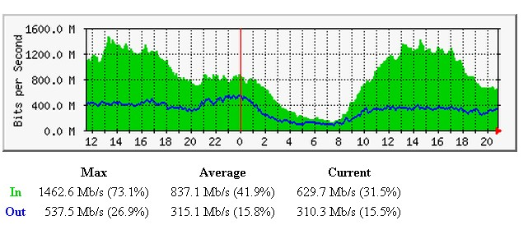
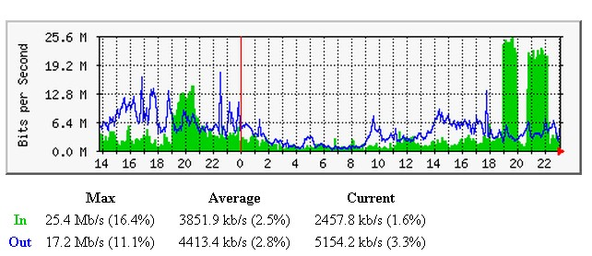
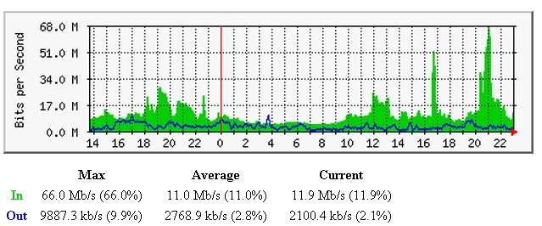
Traffic Analysis
Internet
HKIX
CERNET
TEIN3

Slide 23
HARNET Internet B/W Growth since Year 2000

Slide 24
Collaboration over HARNET
Video Network Services
  Riding on Optical HARNET
  HD video-conferencing through a Polycom RMX 2000 HD MCU
  Joint Webcasting of Lectures, Seminars through a Central web-casting facilities
  On-demand video archives

Slide 25

Collaboration over HARNET
25Mbps
HD Camera
VLC Server
HD MPEG2 encoder
25Mbps
25Mbps
LCD TV
LCD TV

Slide 26
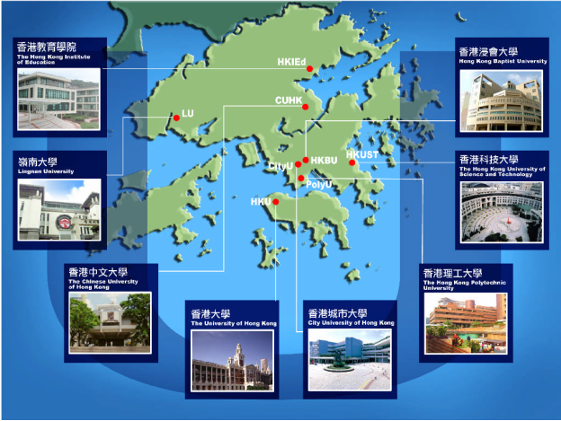
Collaboration over HARNET – Universities Wi-Fi

Slide 27
Collaboration over HARNET – Universities Wi-Fi
Enables inter-operable and fast Wi-Fi network communication among all JUCC institutions
Common authentication framework
  IEEE 802.1x
  Radius authentication
SSID: “Universities WiFi”.
Project cost: HK$7.49 million
Launched in September 2009

Slide 28
Current R&E Network Applications
Video Conferencing
  DVTS-plus (CUHK- Tsinghua University)
Remote Machinery real-time control (PolyU-Singapore)
Collaborative teaching
Distant learning
DNA Database
Weathering information - HKUST
Grid Computing - HKU
Medical Imaging Sharing / Tele-Medicine – CUHK
P2P Streaming - CUHK- Tsinghua University

Slide 29

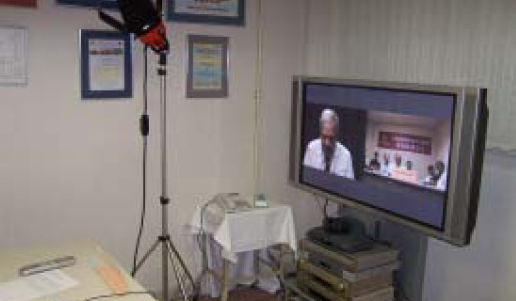
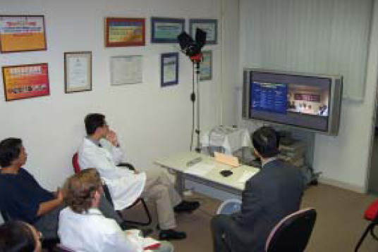
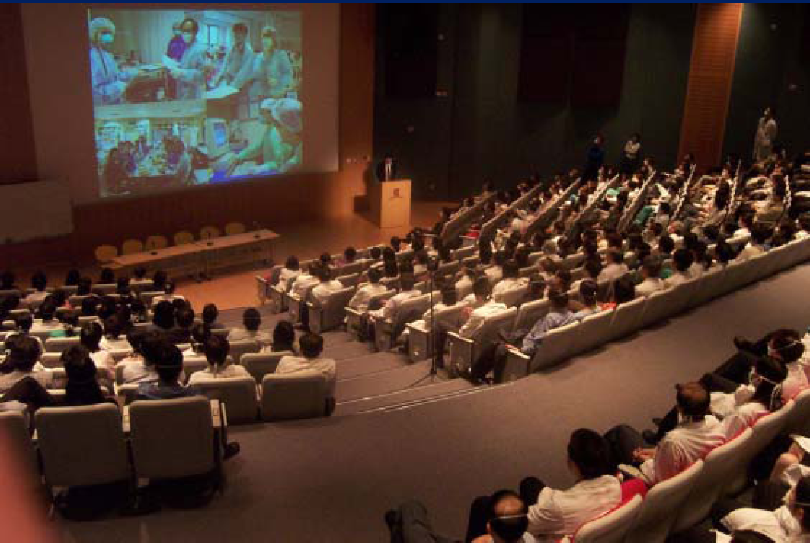
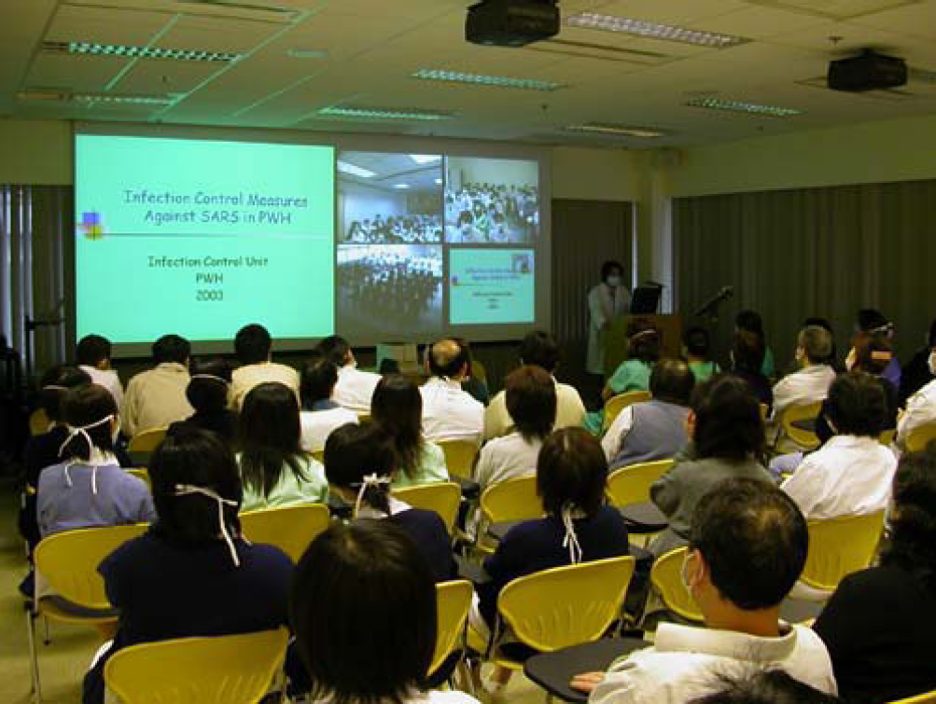
Tele-Medicine

Slide 30
Future HARNET Collaborations / Projects
IPv6
Library & Medical Applications
Telepresence
Disaster & Recovery via Optical HARNET
Cloud Services
HPC
Shared e-learning
ERP
SAN etc.

Slide 31
Thank You

