Slide 1
GLORIAD in Asia Workshop
Update on KREONet2/KRLight
January 19, 2012
Buseung Cho
Seunghae Kim
Dept. of KREONET Service
KREONET Center
KISTI
Notes:
(Communities and Applications, Facilities, Activities and Future Plans)

Slide 2
CONTENTS
▷ KREONET/KREONET Advanced Network
▷ KREONet2/KRLight Facility and Connectivity
▷ Applications and Communities
▷ Future Plan

Slide 3
▷ KREONET/KREONET Advanced Network
▷ KREONet2/KRLight Facility and Connectivity
▷ Applications and Communities
▷ Future Plan

Slide 4
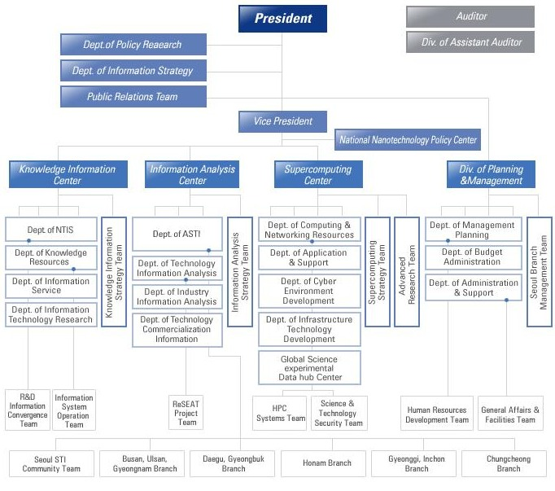
Change in KISTI Organization (2012)
Information Service Center
…
NTIS Center
…
Information & S/W Research Center
…
President
Vice President
TCI Center
…
Information Analysis Center
…
SMB knowledge support center
…
Supercomputing Center
Director: Dr. Jeesoo Lee
…
KREONET Center
Director: Dr. Hyeakro Lee
Dept. of KREONET Service
Manager: Dr. Seunghae Kim
(Manager of KREONET Project)
=> Administration for KREONET and GLORIAD-KR
Dept. of Science & Technology Security
KREONET Service Development Team
Buseung Cho (bscho@kisti.re.kr) :
=> (Contact Point) KREONET International Networking including KRLight and GLORIAD-KR
2011

Slide 5

KREONET
Korea Research Environment Open Network
Korea’s National Science & Research Network
    Funded by Korean government since 1988
Up to 200Gbps Backbone between Seoul and Daejeon
Hybrid Network
    Packet Switched Network, Circuit Switched Network
Supports 1Gbps & 10Gbps User Connections
About 200 connected R&E organizations in Korea
    Universities, Research Institutes, Government Organizations
    About 60 gigabit user (1G/10G) of HEP, Climate Changes, Astronomy, Bio, Medical Science, Future Internet etc.
365*24 NOC (Network Operation Center) Service
Application support
  Lightpath Provisioning and Dynamic Ethernet Service for Advanced Applications
  IP Production Networks for General R&E Applications
Notes:
5

Slide 6
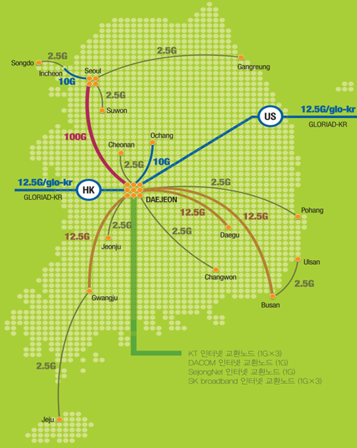
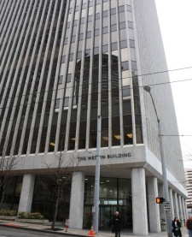
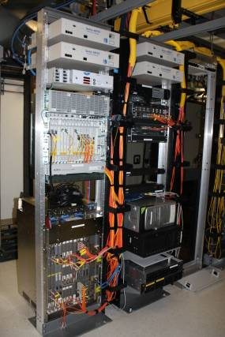
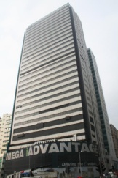
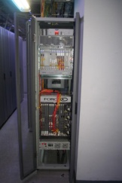

KREONET Backbone
Seattle PoP,
Westin Building (collocation in PNWG), US
HongKong PoP,
Mega-I Advantage, Hong Kong, CN
Hybrid Network with 16 Regional GigaPoPs and 2 International GigaPoPs (Seattle and Hong Kong)

Slide 7
KREONET
KISTI National Supercomputing Network
PLSI Network
KREONET IP Production Network
KREONET Advanced Network
Cyber Convergence Network
KISTI Network
E-KVN
KISTI Branch Network
OpenFlow, @KREONET
KREONET
SuperSIReN
…
KRLight

Slide 8





KREONET
KREOENT Hybrid Network Service Architecture
Application
Application
Application
Application
Application
Application
Gigabit
Routed IP
(Layer 3)‏
Gigabit
SONET/SDH Channel
Carrier Ethernet
(Layer 2)‏
SONET/SDH Channel
Optical Transport (Layer0/1)‏
KREONET User
KREONET Backbone
KREONET User
Layer 3 IP‏
Layer 2 Ethernet‏
Layer 0-1 DWDM, SONET/SDH

Slide 9
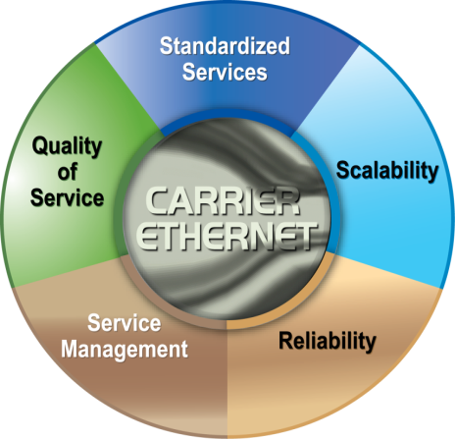
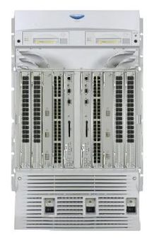
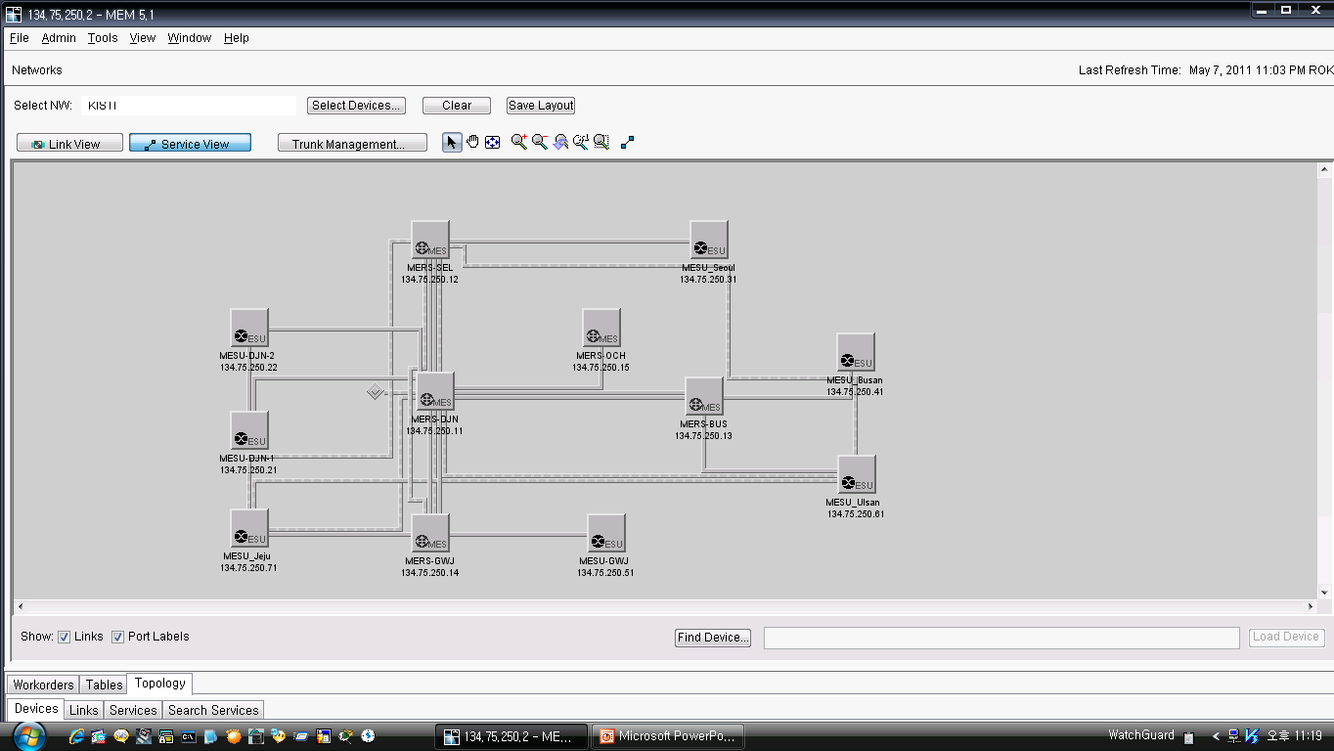
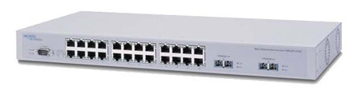
KREONET Dynamic Ethernet Service
KROENET Dynamic Ethernet Service
KREONET’s New Approach based on Carrier Ethernet
1:1(End-to End), 1:M, M:N Bandwidth Guaranteed Service
  E-LAN, E-LINE, E-TREE Service
PBB(Mac-in-Mac, IEEE 802.1ah), PBB-TE(IEEE 802.1Qay)
L2 Optical Private Network
Nortel/Ciena MERS 8610, MESU 1850
Application: E-KVN (Korea’s E-VLBI), Openflow@KREONET, DEFINE_Testbed@KREONET etc
MERS8610
MESU1850
<Metro Ethernet Manager>

Slide 10
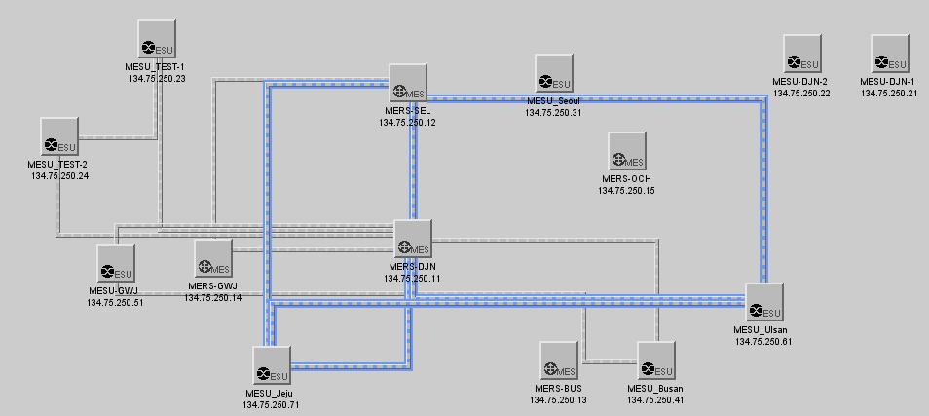
E-KVN

Slide 11
▷ KREONET/KREONET Advanced Network
▷ KREONet2/KRLight Facility and Connectivity
▷ Applications and Communities
▷ Future Plan

Slide 12
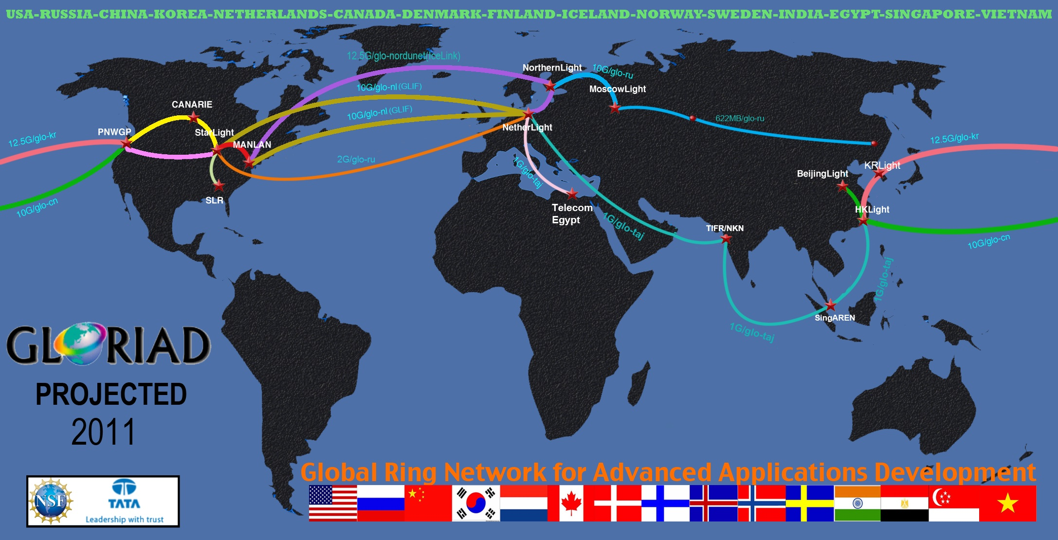
GLORIAD and GLORIAD-Taj
Partners: SURFnet, NORDUnet, CSTNet (China), e-ARENA (Russia), KREONET (Korea), CANARIE (Canada), SingaREN, ENSTInet (Egypt), National Knowledge Network (NKN), NLR/Internet2/NLR/NASA/FedNets

Slide 13
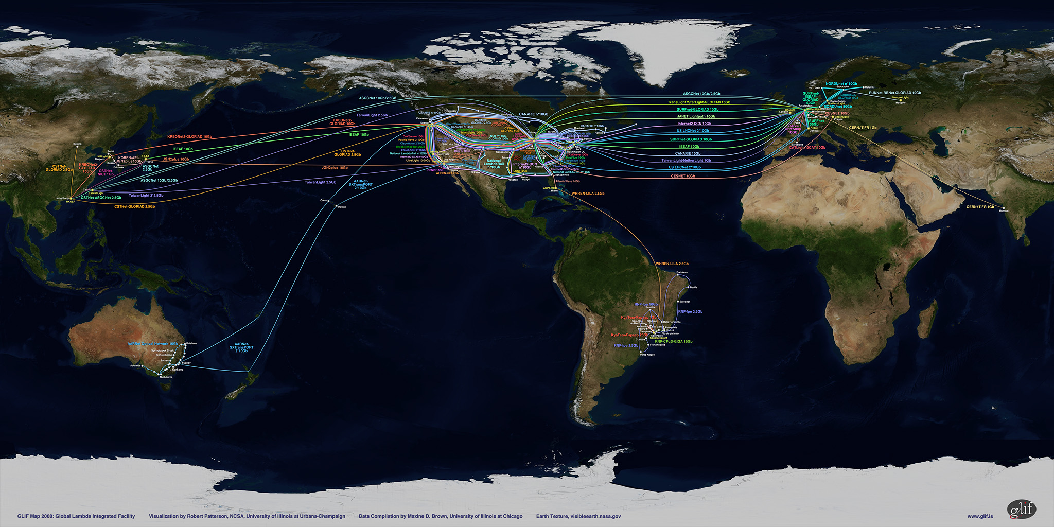
GLIF (Global Lambda Integrated Facility)
Linking the world with lambda !

Slide 14
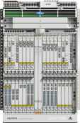


KRLight Facilities
ActiveFlex DD
ActiveFlex DD
225km
100G*N (lambda)
Daejeon, KR
Seoul, KR
L2SS Card
L2SS Card
OME6500
OC192
OME6500
OME6500
OC192
OME6500
OC192
OC48
OC48
1G x 12ea
1G x 12ea
1G x 12ea
1G x 12ea
Force10 E600
Cisco7609
1G x 12ea
Cisco7609
Force10 E600
Force10 E600
Hong Kong, CN
@Mega-i Advantage
Seattle, US
@Westin Building
IP Production Network + Advanced Network
Daejeon, KR
@KISTI
10GE
1GE
Notes:
+L2SS

Slide 15











KRLight Connectivity on GLORIAD-KR
Internet2, ESnet,
ASGCnet , CERN,
MREN, TWAREN,
GLORIAD-US
-US
10Gbit/s
10Gbit/s
Chicago
CANARIE
CANARIE
IRNC-GLORIAD
GLORIAD-US
Univ. of Hong Kong
CA*net4, Internet2,
PNWGP, CENIC
UltraLight, Esnet,
AARNET, NLR
KAREN
2*1Gbit/s
(up to 10Gbit/s)
1Gbit/s
IRNC-GLORIAD
CANARIE
Univ. of Hong Kong
Univ. of Hong Kong
10Gbit/s
IRNC-GLORIAD
KREONet2
CERNET(CNGI-6IX)
CERNET(CNGI-6IX)
1Gbit/s
KREONet2
Seattle
Daejeon, KR
Hong Kong, CN
Seattle, US
CERNET
KREONet2
KREONet2
IRNC-GLORIAD
KREONet2
CUHK, HARNET
APAN-JP, Microsoft,
ASNet, NUS, JGN-X …
1Gbit/s
ASGC
ASGC
1Gbit/s (up to 10Gbit/s)
HKIX
KREONet2
KREONet2
Google
Google
Hong Kong
CSTNET
(HKOEP)
1Gbit/s
1Gbit/s
KRLight Topology - May, 2011
(Buseung Cho, bscho@kisti.re.kr)
KREONet2 <- supplies connection
KREONet2 <- operates connection
2*10Gbps
Google
(IPv6)
ASGC
KREONet2

Slide 16
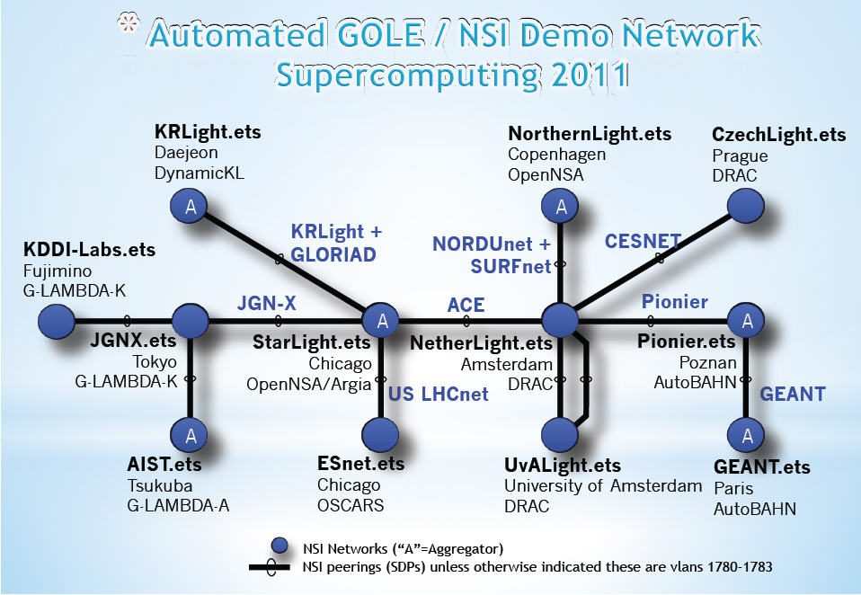
GLIF Automated GOLE Pilot Project
Demonstration the OGF Network Services Interface (NSI) architecture for standardized global inter‐domain provisioning of high performance network connections

Slide 17
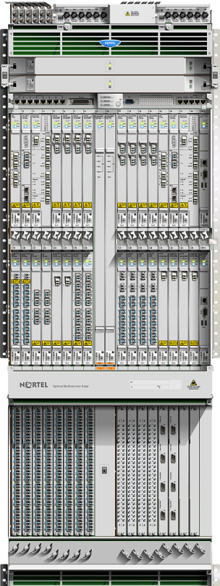
Test and Deployment of 100G Transport System
Test of the 100Gbps/1 lambda Transport System based on
Optical Fiber between Seoul and Daejeon,
the Distance is about 220Km
First Deployment and Service in Asia
Ciena/Nortel ActiveFlex (OME) 6500 Double Decker
  Packet-optical platform, ROADM/DWDM/MSPP
  TDM/WDM/Ethernet/OTN
  Ethernet Aggregation, EVP LAN
  GFP, VCAT, LCAS support etc.
Supports carrying KREONET Backbone traffic and large-scale
scientific applications for KROENET advanced scientific users
Integrated with KREONet2 and KRLight

Slide 18
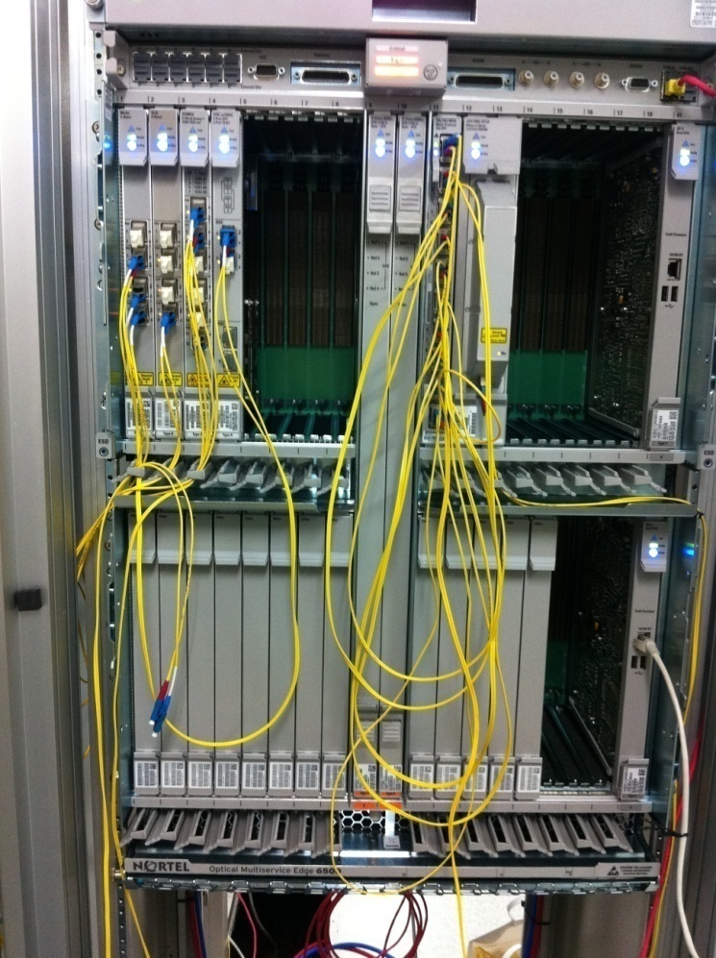
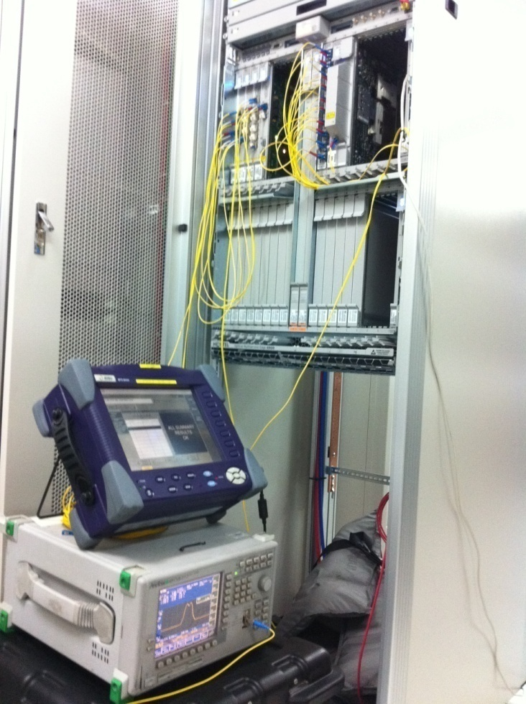
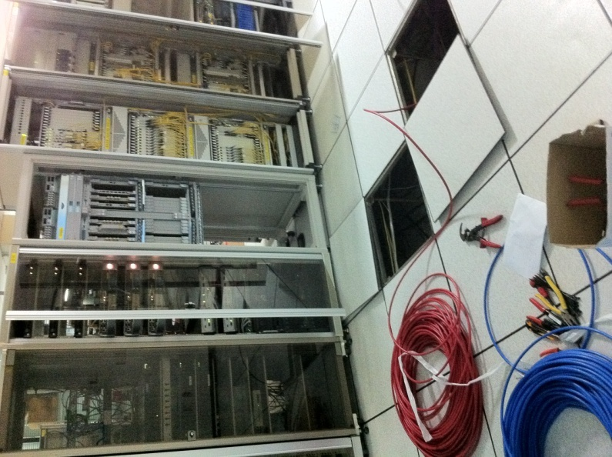
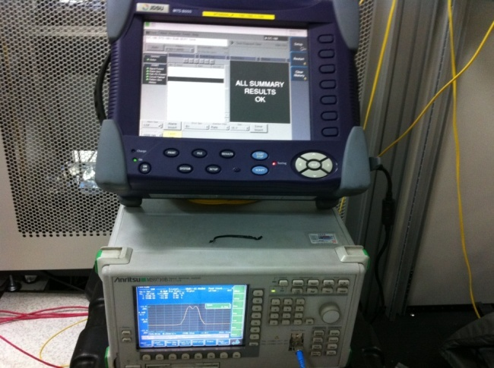
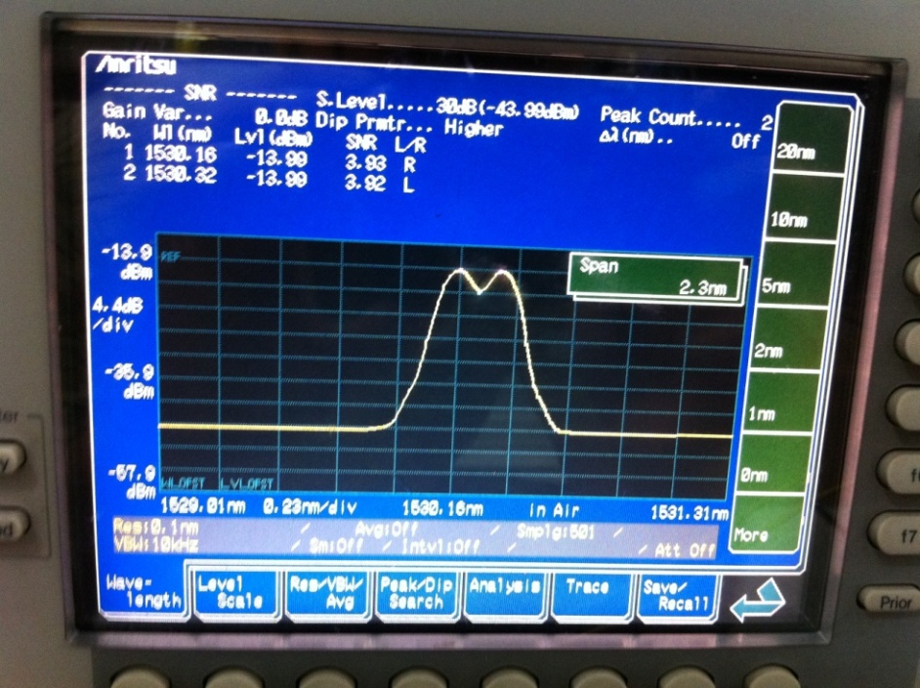
Test environment

Slide 19
▷ KREONET/KREONET Advanced Network
▷ KREONet2/KRLight Facility and Connectivity
▷ Applications and Communities
▷ Future Plan

Slide 20
Applications and Communities
10 Strategic R&D Support Programs
E-KVN (Korean e-VLBI Network)
Korean Data Center for SDO
OpenFlow@KREONET
DEFINE_Testbed@KREONET
Sharing National Large-scale Experiment Facility
PLSI (Partnership and Leadership for the nationwide
Supercomputing Infrastructure)
Cyber LAB Project

Slide 21
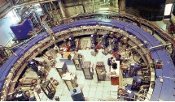
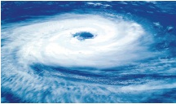
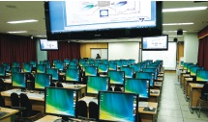




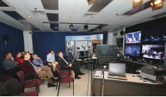

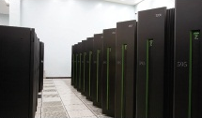
10 Strategic R&D Support Programs
Supporting Specialized Private Networks per Scientific R&D Application as Service-enabled Infrastructure
High Energy Physics
Weather&climate
Education & Collaboration
Medical Science
Future Internet
astronomy
New Medicine/Bio
Culture & Art
Constructions
Supercomputer

Slide 22
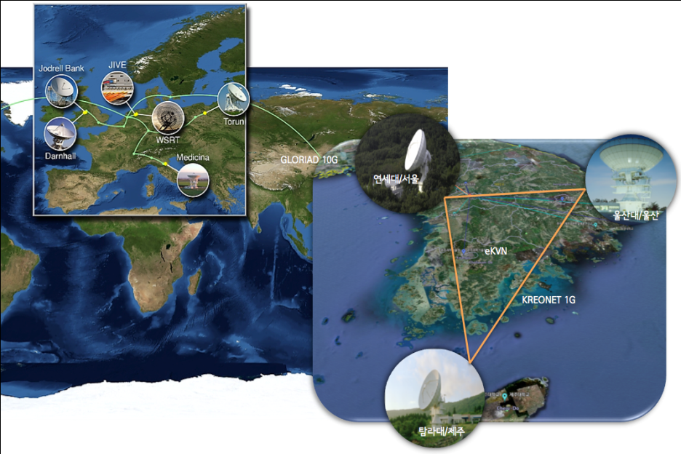
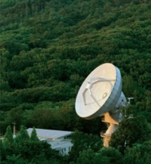



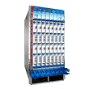

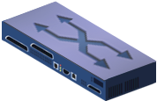
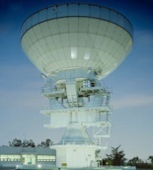
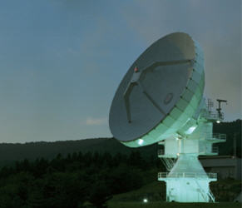

e-KVN over KREONET and KRLight
e-KVN: Korean e-VLBI(electronic Very Long Baseline Interferometry) Network
Participants: Korea Astronomy & Space Science Institute (KASI), KISTI
JIVE
Yonsei Astronomy Observatory
C2960
IP Production Network
1G
10G
1G
10G
Yonsei Data Center
C3560
1G
C4506
T640
Seoul
Daejeon
1G
Jeju
1G
C2960
Ulsan
C2960
Tamna Astronomy Observatory
Carrier Ethernet Switch
E-LAN Service type
(Multipoint-to-Multipoint EVC)
Ulsan Astronomy Observatory

Slide 23
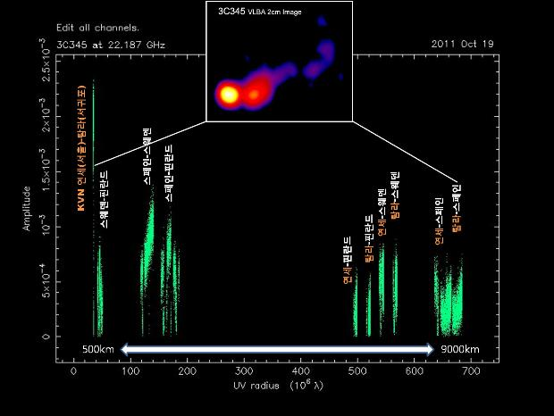
Real-time Observations on e-KVN
First real-time observation (Oct. 2011)
  International Participant: JIVE (in Netherland)
  Observatories: Yonsei & Tamna Astronomy Observatory , Spain Yebes 40m Astronomy Observatory, Sweden Onsala and Finland Metahovi Astronomy Observatory
  Distance between observatories : 9,245 Km
  AGN(Active Galactic Nuclei) Observation
    3C345 and 1308+326
Second real-time observation
(just plan, 2012)
  International Participant: ATNF
  (Australia Telescope National Facility)
Notes:
http://www.kasi.re.kr/View.aspx?id=report&page=0&si=False&sn=False&ss=True&sc=False&keyword=&pagesize=20&uid=3645

Slide 24
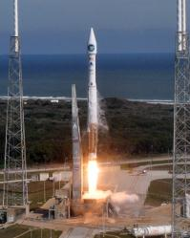
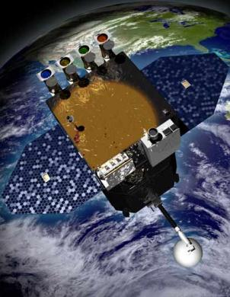
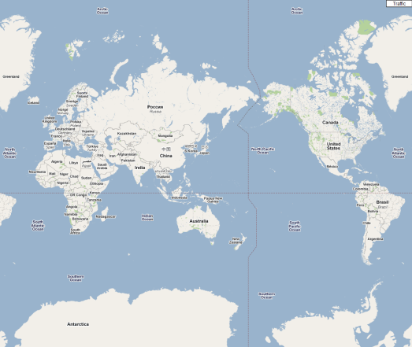








Korean Data Center for SDO
(Cooperation between NASA and KASI via KRLight)
SDO (Solar Dynamics Observatory)
Launched on 11 February 2010
UCLan,
United Kingdom
KDC for SDO
KASI , Korea
SDO at SIDC
ROB, Belgium
JSOC (AIA and HMI)
Stanford Univ. and
LMSAL, USA
IAS,
France
EVE
Univ. of Colorado
at Boulder, USA
GDC for SDO
DLR, Germany
Full Data
Short-term and Selected Data
DLR, Deutsches Zentrum für Luft- und Raumfah
(German Aerospace Center)
GDC, German Data Center
IAS, Institut d'Astrophysique Spatiale
JSOC, Joint Science Operations Center
KDC, Korean Data Center
LMSAL, Lockheed Martin Solar and Astrophysics Lab
ROB, Royal Observatory of Belgium
SIDC, Solar Influences Data Center
UCLan, University of Central Lancashire
Refer to Seonghwan Choi and Eunmi Hwang (KASI)

Slide 25
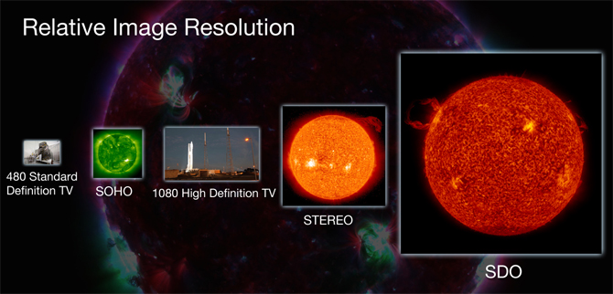
SDO will send 1.5 terabytes of data back to Earth each day, which is equivalent to a daily download of half a million songs onto an MP3 player.

Slide 26
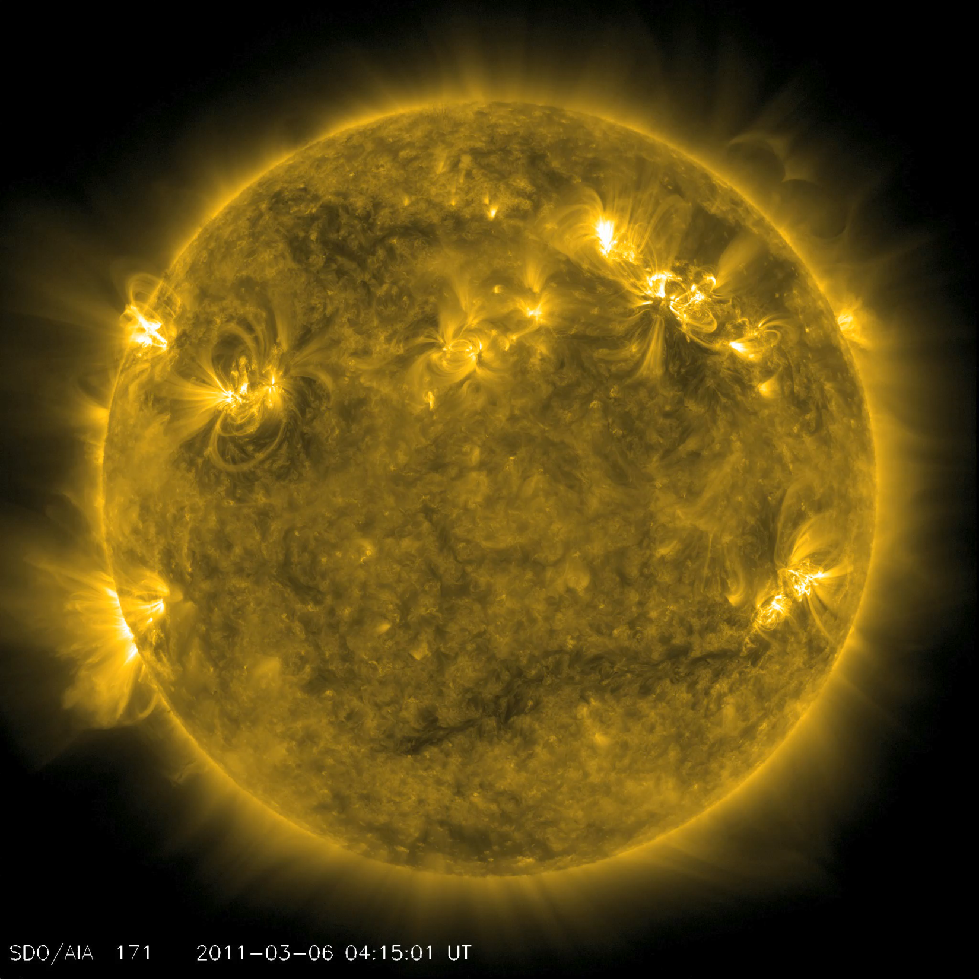

Slide 27
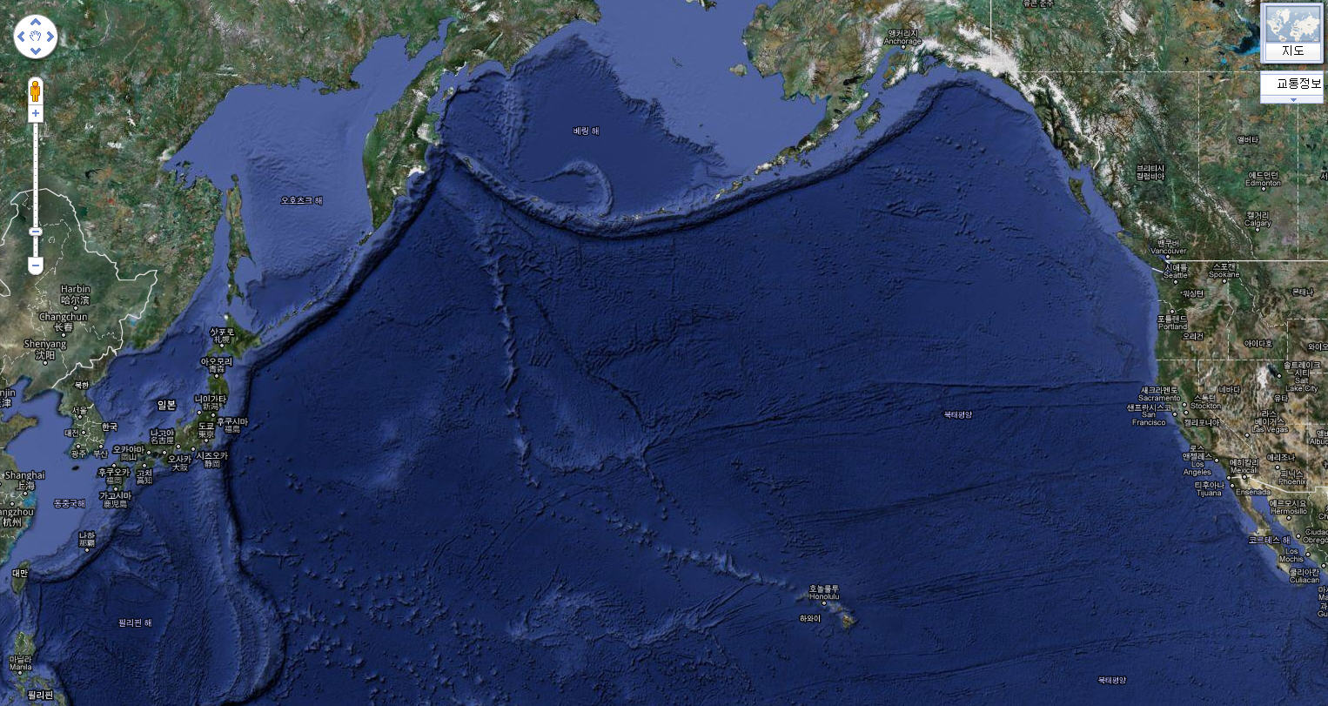
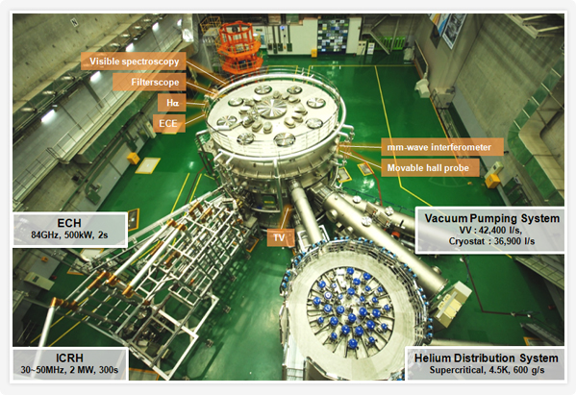
NFRI’s KSTAR Project
KSTAR : Korea Superconducting Tokamak Advanced Research
KSTAR first plasma occurred, in 2009
World-wide fusion research center as an ITER pilot device
Sharing the experimental data and remote-controlling the experiment
  International Partners: NFRI (National Fusion Research Institute), GA (General Atomics)
ESnet
NFRI
GA

Slide 28




OpenFlow@KREONET over KROENET and KRLight
OF Seoul (~ A540)
5
7
OF
VLAN 10
Non-OF
VLAN 1
8
Seoul
22
21
Trunk
(VLAN10)
Trunk
(VLAN10)
Chungnam Univ. Lab #2
PBB-TE Trunk
GIST Lab.
MERS 8610-SE
NOX 2
VLAN10
VLAN10
UTP-6
Listener port #: 975
Chungnam Univ. Lab #1
Nortel
Baystack 380-24T
PBB-TE Trunk
MERS 8610-DJ
MERS 8610-GJ
Force E300
Trunk(VLAN10, ?)
PBB-TE Trunk
Trunk(VLAN10, ?..)
SuperSiReN
GwangJu-Router
PBB-TE Trunk
Trunk
(VLAN10)
Trunk
(VLAN10)
Trunk
(VLAN10)
Trunk
(VLAN10)
Cisco 7609
VLAN10
22
21
22
21
Cisco 7609
VLAN10
7
OF
VLAN 10
Non-OF
VLAN 1
Non-OF
VLAN 1
OF
VLAN 10
7
8
8
Daejeon
5
5
Gwangju
Notes:
iGENI

Slide 29
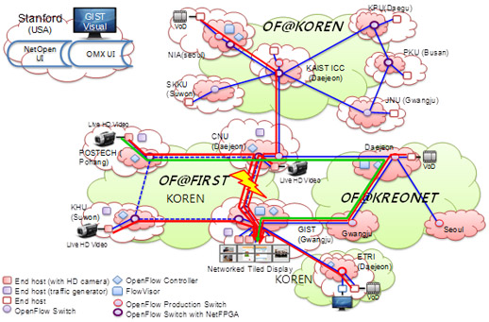
Notes:
Opennetworking 시연 추가

Slide 30




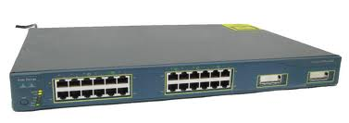

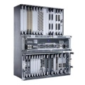
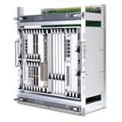
DEFINE_Testbed@KREONET
Objective : Implementation of QoS functionality for OpenFlow
Participants: Jeju Univ. Kyungnam Univ. National Institute for Mathmatical Science (NIMS), KISTI
Daejeon
OF-Host
DJ-7609
VLAN3
VLAN2
Gwangju
VLAN3
G8/7 [VLAN811]
VLAN2
[VLAN 2, 3]
Cisco 3500
NOX-Controller (Server)
Jeju
MERS8610
Cisco 7609
NIMS
STM2
STM2
MESU1850
1850TSS-100
1850TSS-320
VLAN3
VLAN1
1850TSS-100
OF-Host
Changwon
Jeju Univ.
Jeju-Router
STM2
Cisco 7609
Cisco 7609
DEFINE: DEveloping Future Internet NEtwork model of NIMS
VLAN2
VLAN1
OF-Host
Kyungnam Univ.
MESU1850
1850TSS-100
1 Gigabit Ethernet
KREONET IP Production Service
Changwon
Notes:
구성도 다시 확인, 목적 확인

Slide 31
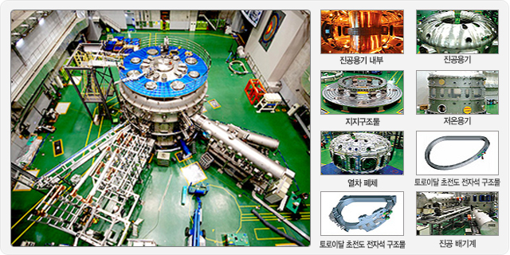
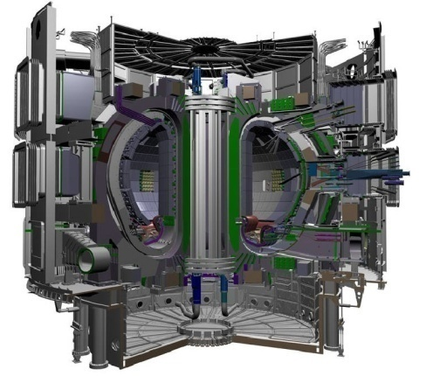
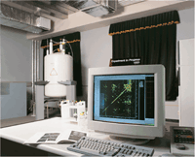
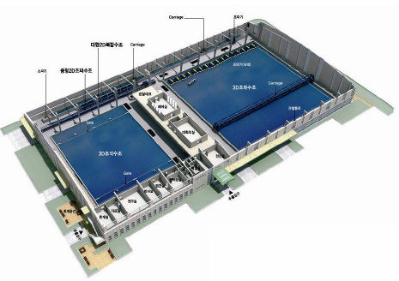
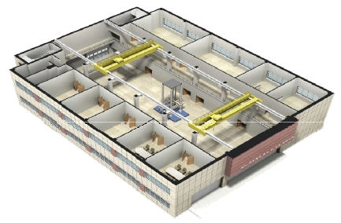
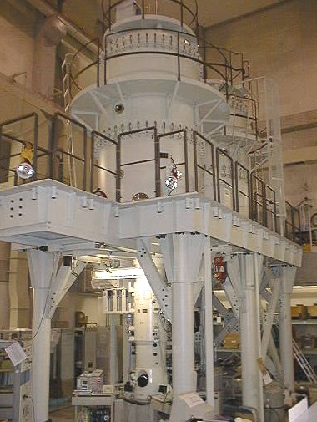



Sharing National Large-scale Experiment Facility
HF-NMR (High Field-Nuclear Magnetic Resonance)@Korea Basic Science Institute
KSTAR (Korea Superconducting Tokamak Advanced Research)@National Fusion Research Institute
ITER,
World’s largest Tokamak
Hybrid Structural Testing Center
Wind Tunnel Center
Wave Simulation & Research Center
Geotechnical Centrifuge Testing Center
Advanced Construction Materials Testing Facility
Multi-platform Seismic Simulation Center
@KOCED
HVEM (High Voltage Electron Microscope) @Korea Basic Science Institute

Slide 32










PLSI (Partnership and Leadership for the nationwide
Supercomputing Infrastructure)
Collecting distributed Supercomputing resource and sharing as nationwide Supercomputing Infrastructure over KREONET
5 Base (Regional) Centers, 10 SC Partners (Organizations)
380.676 TFlops
SNU SC
KIST SC
Konkuk Univ. SC
UOS SC
KOBIC
KISTI SC
PLSI Network is a dedicated group network over KREONET with 1Gbps
UNIST SC
Dongmyung Univ. SC
PNU SC
GIST SC
PKNU SC
Notes:
연동 기관 및 연동 자원 확인 필요

Slide 33














Cyber LAB Project
Global Education and Research Environment Through real-time high quality
collaborative cyber LAB
- Development and support for cyber convergence research and educational system
management
Tiled Display
Convergence research & education
Remote e-learning
Tele-surgery etc.
MCU
Research Platform
HDS
PolyCom
Education Platform

Slide 34



Full HD Robotic Operation Broadcast, APRICOT/APAN in Hong Kong
Transmission of an uncompressed 3D Full HD signal of a prostate carcinoma surgery, performed using the da Vinci robot under the command of the senior consultant of the department of urology of the Masaryk Hospital
KRLight
GLO-KR OME6500Hongkong
(STS-3c-21v)
GLO-KR
OME6500Daejeon#2
StarLight
Chicago
NetherLight
OC192-1-9
OC192-1-9
T2/1
OC192-1-6
VLAN 440, 441
VLAN 440, 441
VLAN 440, 441
(STS-3c-21v)
Trunk
T1/0
OC192-1-6
GLO-KR
Force10 E600
Hongkong
GLO-OME6500Daejeon#1
OC192-1-9
GLO-OME6500
Seattle
OC192-1-6
CANARIE HDXc
CESNET
OC192-1-9
(STS-3c-21v)
49 ~ 111
T1/2
(STS-3c-21v)
VLAN 440
VLAN 440
67.58.60.146/27
VLAN 441
10.254.254.4/27
APAN Venue
10G Optical (OC192)
10G Ethernet
Participants: Jiri Vavratil, Michal Krsek (CSTNET), Kitamura Yasuichi (APAN-JP), Koji Okamura (Kyushu university), Alan Verlo (StarLight), Thomas Tom (CANARIE), Li Zhonghui (CERNET), Kwangjong Cho (KRLight), Che-Hoo CHENG (HKIX)

Slide 35


Slide 36
Future Plan
Building KISTI (GSDC) ~ CERN 1G Dedicated Network for becoming an Alice Tier1 of CERN
Extending KRLight connectivity in Hong Kong and Seattle
Adding more 10G bandwidth between Korea to US
Supporting advanced (data intensive) scientific application users
Deploying dynamic allocation system like OpenDRAC
Deploying GLORIAD-Earth System

Slide 37

(PLAN) Alice Tier1 Center, KISTI GSDC
End-to-End 1G Dedicated Circuit between KISTI and CERN
Alice Tier 1 Center of CERN
KRLight (Seattle)
Arranged and provisioned by SURFnet
NetherLight
CERN
StarLight
KISTI
Provisioned by KISTI
Provisioned by CANARIE
(MANLAN)
Created by Buseung Cho (bscho@kisti.re.kr, KISTI)
2012. 1. 16.

Slide 38
Thank You!
bscho@kisti.re.kr, shkim@kisti.re.kr

